Slide 1
Blue Deal
Marcos Martorell, Marcos Gabaldon, Javier Maceda y Marcos Martínez

Slide 2
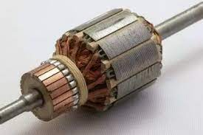
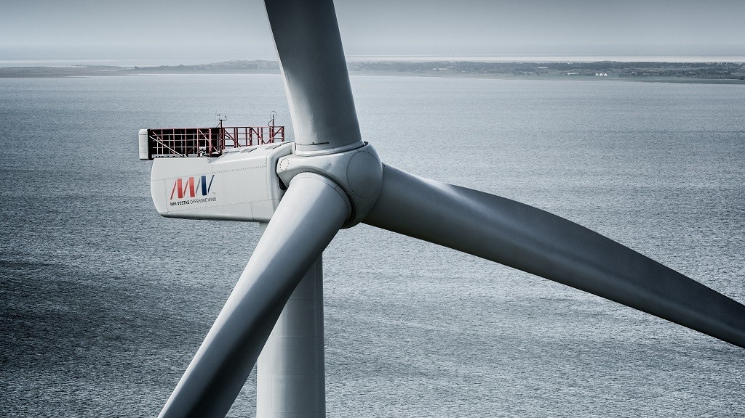
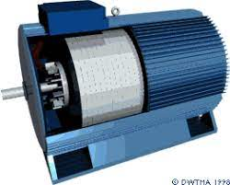
WIND TURBINES WHAT ARE THEY?
WHAT ARE THEY FOR?
Wind turbines, systems that allow energy to be generated through the movement of air.
Parts:
-Blades, produce movement with the air.
-Rotor, transmits the movement to the generator.
-Electric generator, converts movement into energy
-Base, where all the parts rest.

Slide 3
Advantages and disadvantages of turbines
- It is a renewable and clean energy
-Wind energy is indigenous
-It is adaptable to almost any space
-It has a quick installation
-It is considered a cheap energy
PROS
-
They take up a lot of space
-Lack of security in the existence of the wind
-It is necessary to build high tension lines
-Involves an environmental impact
-Interferes with the flight of birds and kills many throughout the year.
CONTRAS

Slide 4
OUR IDEA
It is a horizontal windmill model that aims to greatly reduce the visibility of the structure with the beautiful shape of a water lily, the structure will have an internal wiring that is attached to the seabed.
BLADES
ROTOR
FLOATING BASE
ELECTRIC GENERATOR

Slide 5
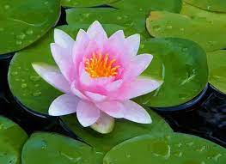
WATER LILY TURBINE:
PROS:
-Greater aesthetics, less obtrusive to the eye, cheaper, consumes fewer natural resources as fewer materials are needed.
-Retains all the benefits of the conventional wind turbine.
-It would put an end to the problem of the death of thousands of annual birds by not interfering with their flight.
CONS:
-Could be slightly less efficient, but can be solved with research to improve the model.
-It can disturb the fish and even damage the ecosystem of the area if it is not strategically placed.

